Slide 1

Moffat Bay Island Marina
By Group 2.

Slide 2
Goals and Purpose
The purpose of this document is to outline the technical design and development plan for the Moffat Bay Island Marina website. The website will allow customers to view marina information, register, log in, reserve long-term slips based on boat size, and manage their reservations. It will also include functionality for waitlists when slips are unavailable. The document will serve as a blueprint for the development, testing, and deployment of the website.
Create a easy to access Marina website that allows any user to book a slip with zero hassle along with creating a backend that will allow for easy management of the reservations.

Slide 3
Color Scheme
White and grays for Backgrouds, Light Blue headings and some text, and Yellow for highlights

Slide 4
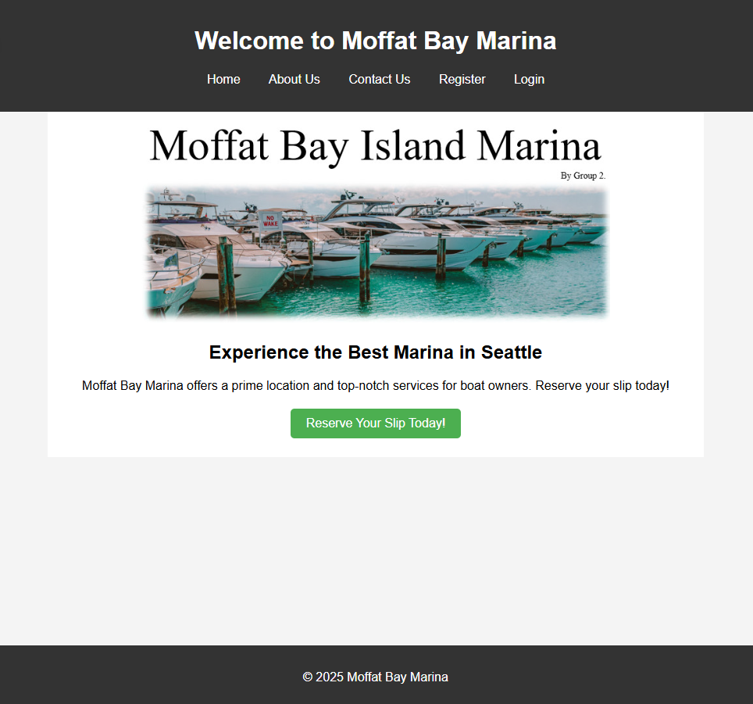

Landing Page

Slide 5
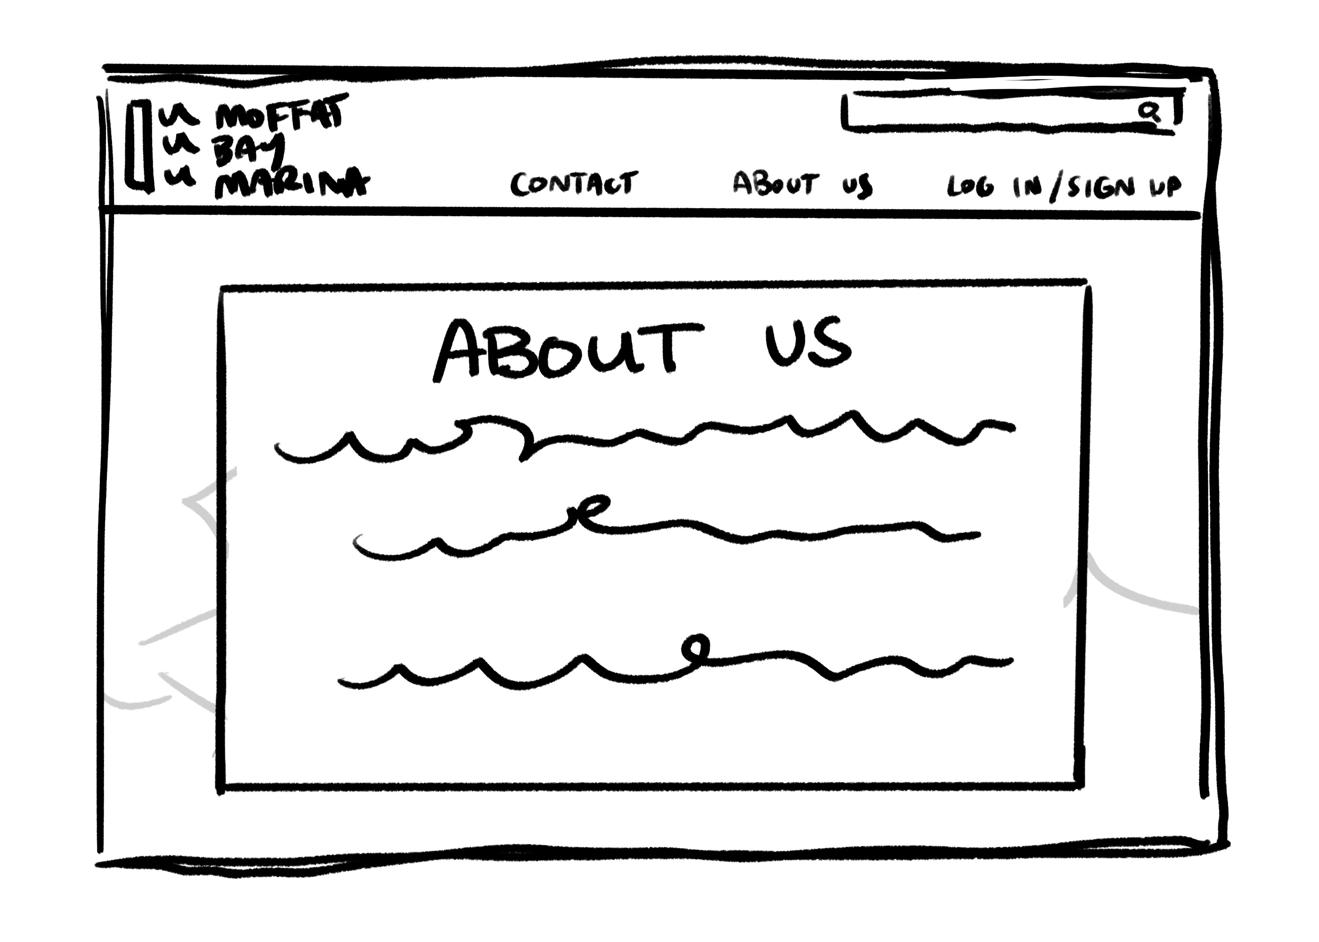
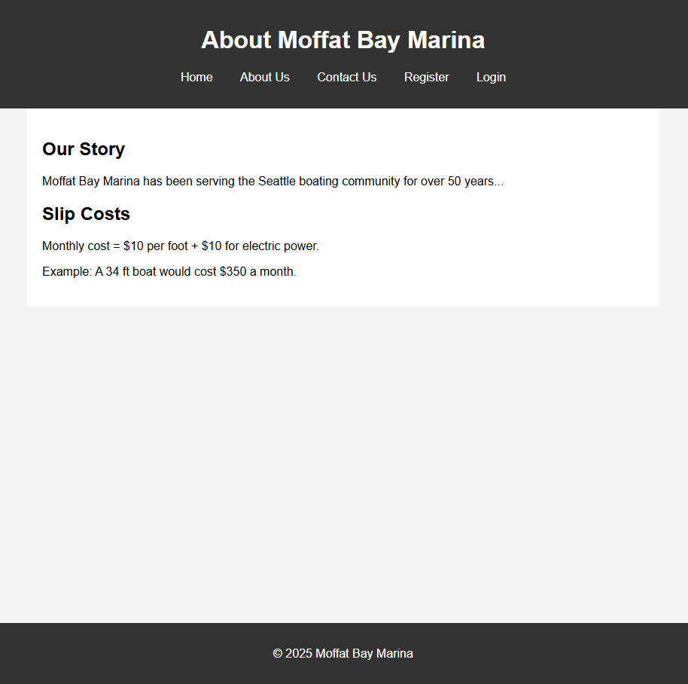
About Us Page

Slide 6
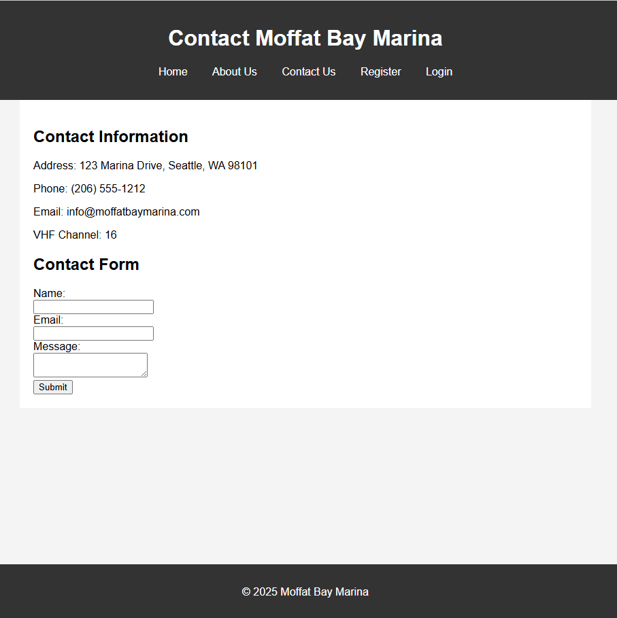
Contact Us Page

Slide 7
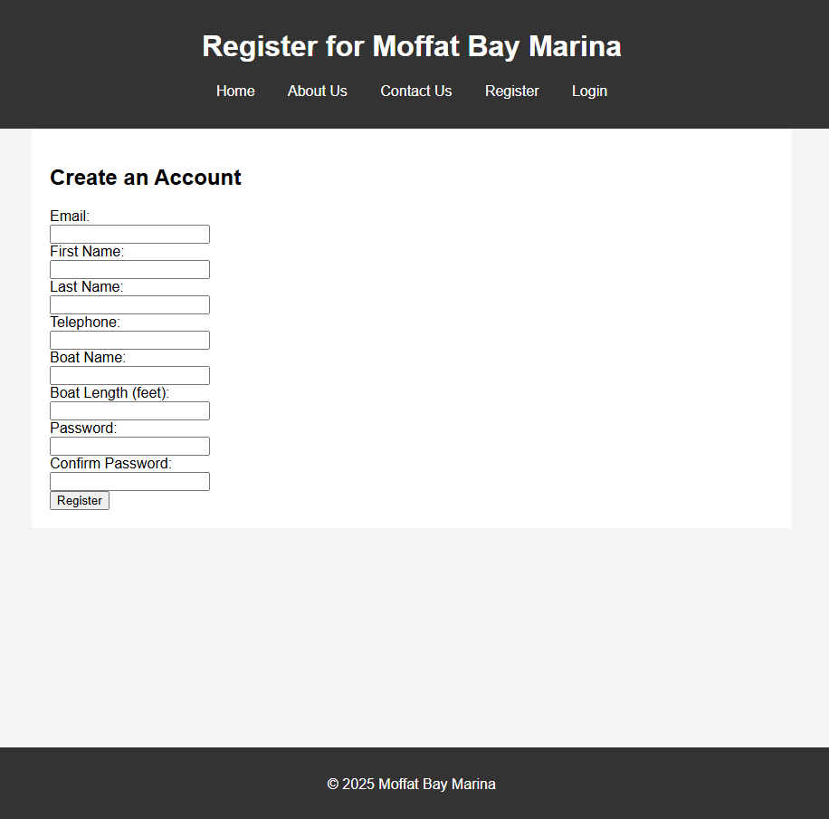
Register Page

Slide 8
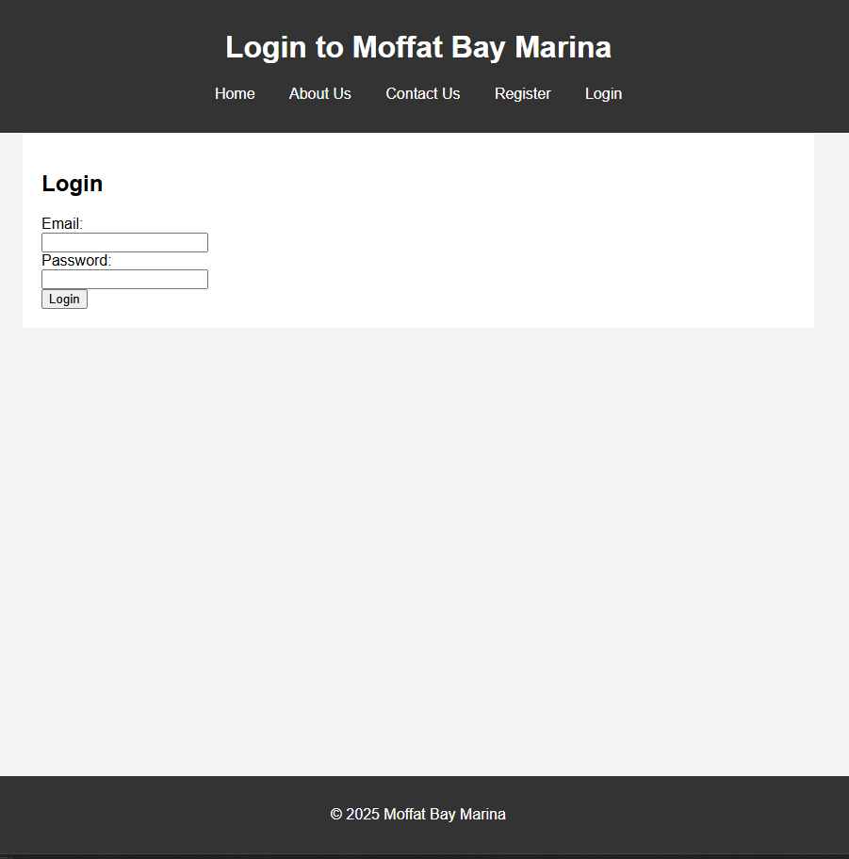
Login Page

Slide 9
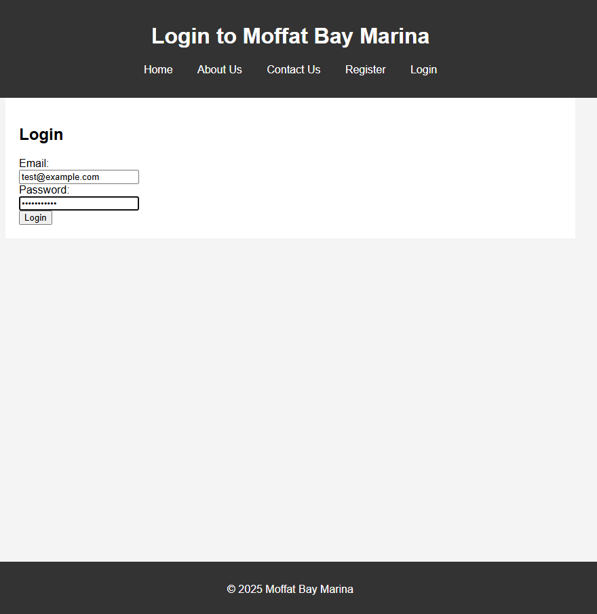
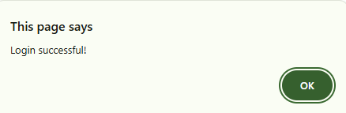
Login Page Success

Slide 10
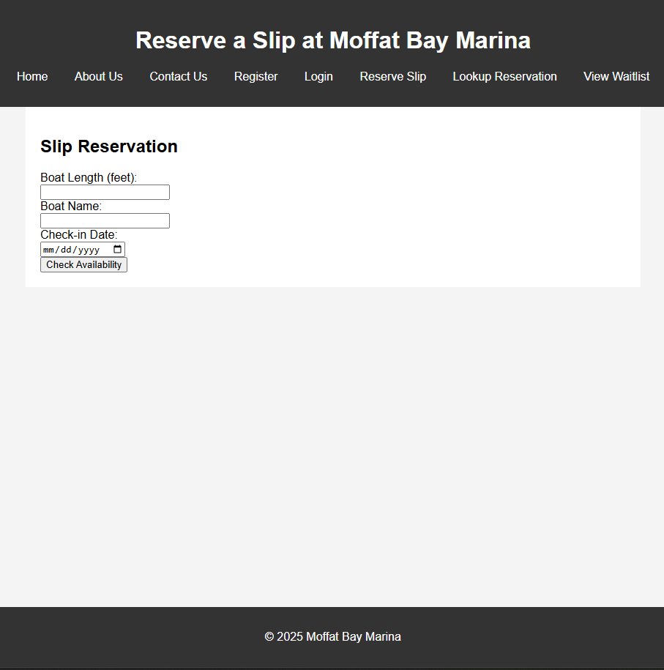
Reserve Page

Slide 11
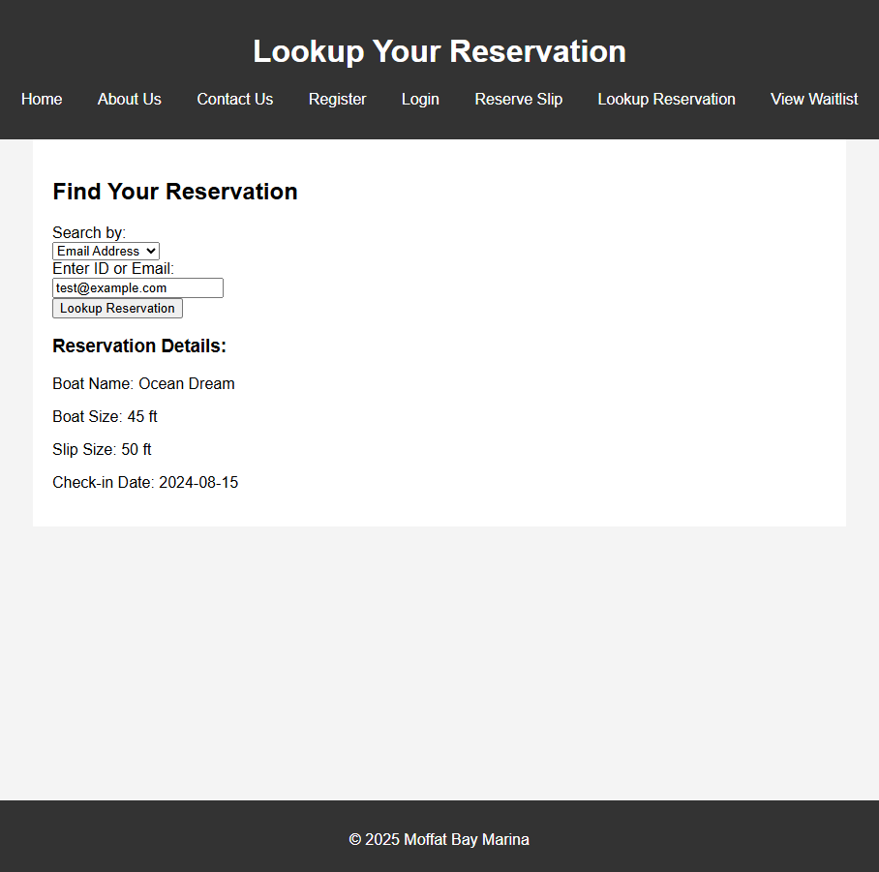
Lookup Page

Slide 12
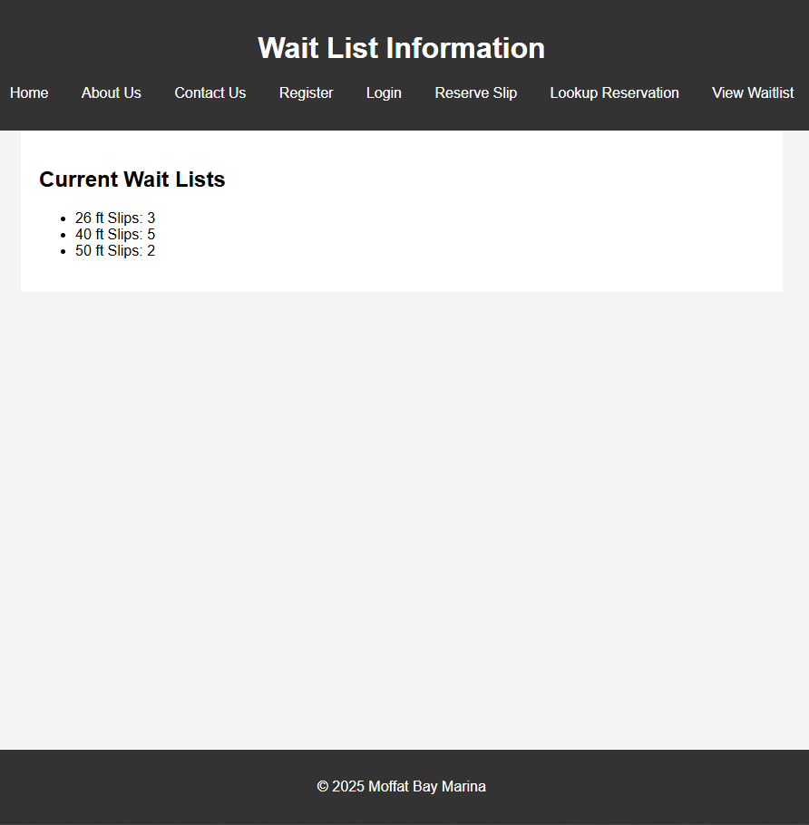
Wait List Page

Slide 13
Timeline For Completion & Estimated Cost
4 Weeks for completion of First pass on website.
1 Weeks of QA
1 week for revisions post testing
$5000 for server setup and development costs.
INITIAL DEVELOPMENT
QA/TESTING
REVISION

Slide 14
Sell our Product / Conclusion

